Slide 1



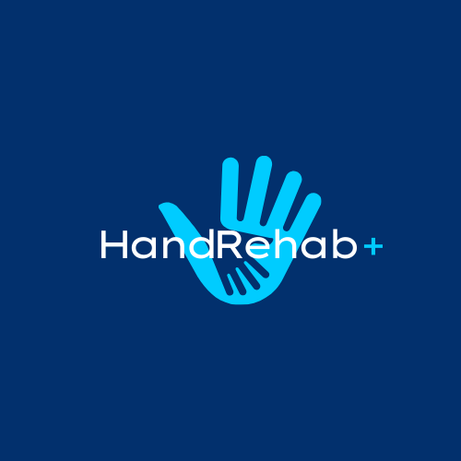



Our Mobile
App Is Coming
Empowering patients and providers through smarter, guided rehabilitation
Austin Cherian, Tsegie Kassahun, Maxwell Lewis

Slide 2


Executive Summary
HandRehab+ is a mobile application designed to support patients and therapists during post-operative rehabilitation. It focuses on tracking exercises, improving adherence, and enhancing recovery through patient-generated data and clinician monitoring.
Post-operative focus: hand, wrist, elbow
Target users: Orthopedic post-op patients and occupational/physical therapist
Key features: Daily surveys, exercise tracking, motivational badges, AI alerts, and therapist/patient dashboard access

Slide 3




Why HandRehab+
Matters!

Slide 4

PROBLEM 1
📉 Adherence to HEPs is low — often just 30–50%
Problem
PROBLEM 2
“As an Occupational Therapist for 8 years, I’ve seen one thing repeatedly:
When patients follow their home exercise program (HEP), they heal better. When they don’t, progress stalls”.
-Tsegie Kassahun OTR/L
🧠 Patients forget how to do exercises or lose their handouts
PROBLEM 3
📂 Therapists lack visibility into home performance

Slide 5
Literature Review

Slide 6
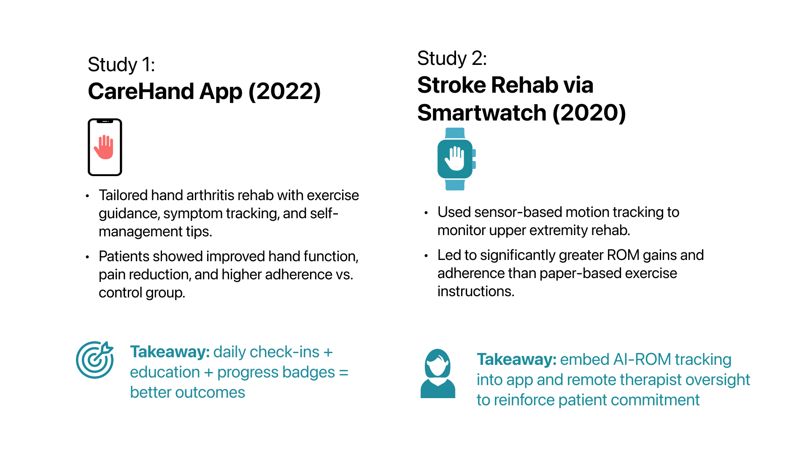

Slide 7

Solution
HandRehab+ is a digital rehab companion that:
SOLUTION 1
SOLUTION 2
SOLUTION 3
📱 Provides video-guided, easy-to-access exercises
⏱ Tracks symptoms and exercise adherence
🧑‍⚕️ Enables therapist monitoring between visits

Slide 8



Our Purpose
& Scope
Purpose:
Address gaps in post-op hand, wrist, and elbow rehabilitation
Improve patient adherence and real-time therapist oversight
Capture patient-generated data (pain, grip, ROM, mood, sleep)
Scope:
Focus: Outpatient post-op orthopedic recovery
Tools: Daily assessments, exercise tracking, AI feedback
Users: Patients and therapists via mobile app
Goal: Enhance rehab engagement and outcomes

Slide 9
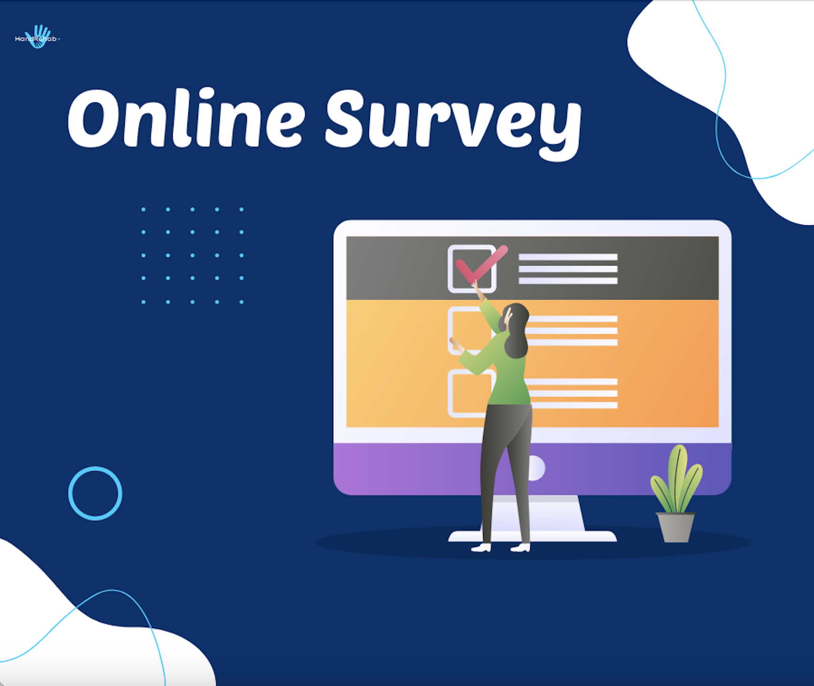

UNDERSTANDING
USER NEEDS

Slide 10
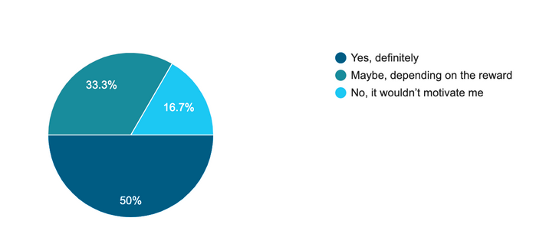
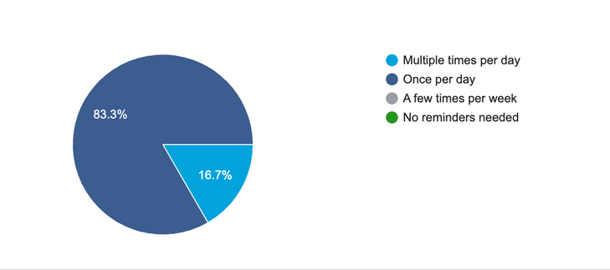
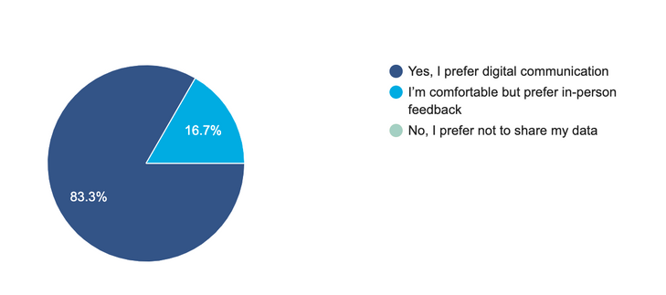
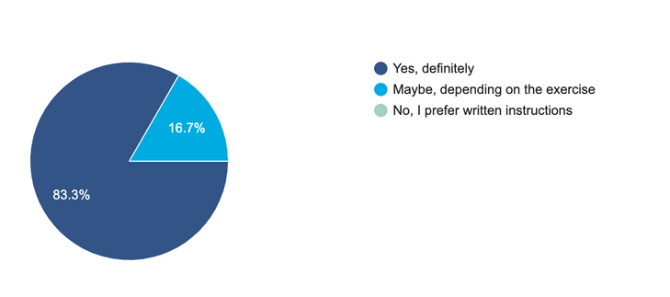
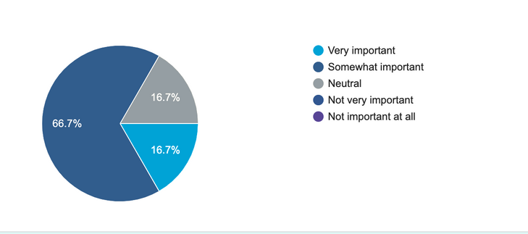
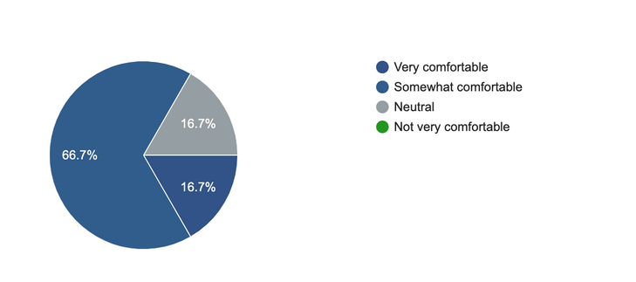
PATIENTS NEED ASSESSMENT SURVEY
Survey results from six patients recovering from upper extremity surgery highlight user preferences around video instructions, data sharing, and AI feedback features.
ENGAGEMENT & MOTIVATION
DATA SHARING & COMMUNICATION
WOULD YOU BE MOTIVATED BY REWARDS AND PROGRESS MILESTONES DURING REHAB?
HOW OFTEN WOULD YOU LIKE REMINDERS FOR YOUR REHAB EXERCISES?
WOULD YOU BE COMFORTABLE SHARING YOUR REHAB PROGRESS WITH YOUR THERAPIST THROUGH AN APP?
INSTRUCTIONAL SUPPORT
TECHNOLOGY COMFORT & ACCESS
WOULD YOU FIND STEP-BY-STEP VIDEO INSTRUCTIONS HELPFUL DURING YOUR REHAB?
HOW IMPORTANT IS IT TO RECEIVE REAL-TIME FEEDBACK ON YOUR EXERCISE FORM?
HOW COMFORTABLE ARE YOU WITH USING MOBILE APPS FOR HEALTH TRACKING?

Slide 11
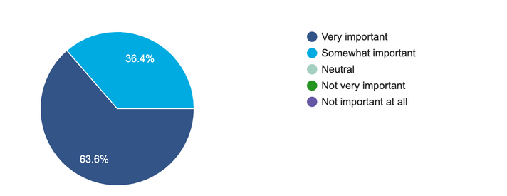
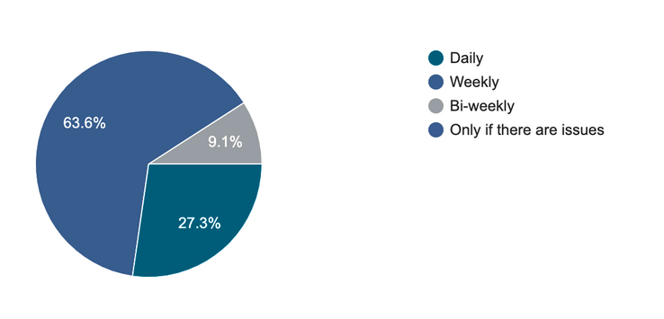
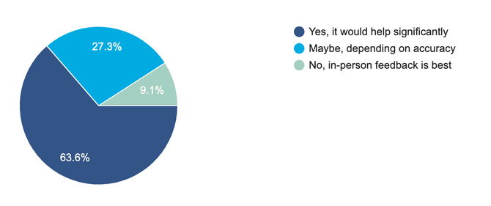
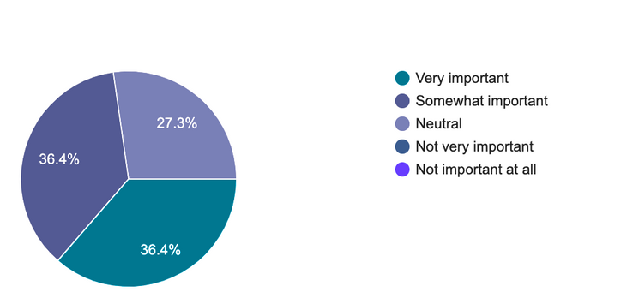
PROVIDER NEED ASSESSMENT SURVEY
Survey results from eleven occupational therapists highlight priorities for remote monitoring, patient communication, and clinical decision support features.
CLINICAL INSIGHT & MONITORING
COMMUNICATION & FEEDBACK
HOW IMPORTANT IS IT TO MONITOR A PATIENT’S GRIP STRENGTH AND RANGE OF MOTION (ROM)?
WOULD AI-BASED REAL-TIME FEEDBACK ON A PATIENT’S EXERCISE FORM BE USEFUL FOR REMOTE MONITORING?
HOW OFTEN WOULD YOU LIKE TO RECEIVE PROGRESS UPDATES FROM PATIENTS?
FEATURE RECOMMENDATIONS
PATIENT ENGAGEMENT STRATEGIES
EDUCATION ON DIAGNOSIS
PATIENT LOG TO TRACK PAIN AND SYMPTOMS
MAYBE EDUCATION ON THE ACTUAL SURGICAL PROCEDURE — VIDEOS OR PRESENTATIONS THAT EXPLAIN IT
VIDEOS OF EXERCISES; KINEMATIC MEASUREMENTS
VIDEO EXAMPLES, ABILITY TO ADJUST GOALS AS NEEDED
PAIN LEVELS, MOTIVATION, COMPLIANCE WITH HEP
OPTION TO ADD VIDEOTAPING AND/OR PICTURES
LOTS OF VISUALS TO SHOW PROGRESS THAT WOULD BE MOTIVATING
14-DAY POST-OP DAILY PATIENT CHECK-IN LOG, INCLUDING:
PAIN SCALE
FUNCTIONAL LIMITATION ASSESSMENT
MOTIVATION QUESTIONNAIRE
HOW IMPORTANT IS GAMIFICATION (BADGES, STREAKS, PROGRESS MILESTONES) IN MOTIVATING PATIENTS?

Slide 12
Personas

Slide 13
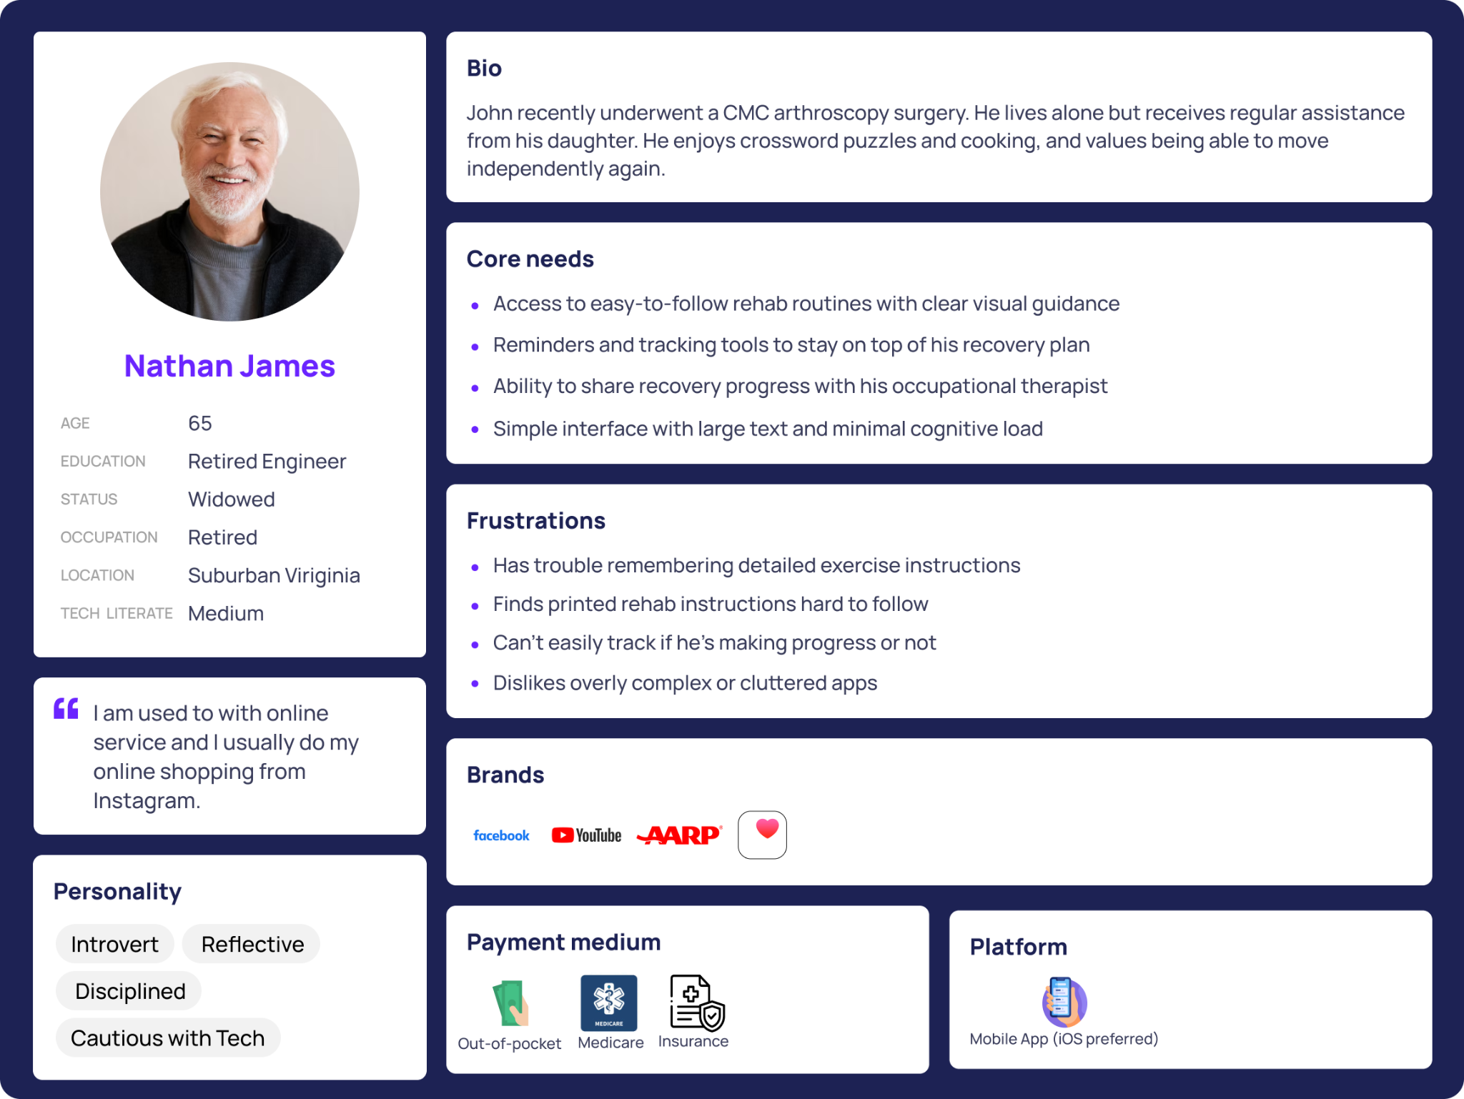

Slide 14
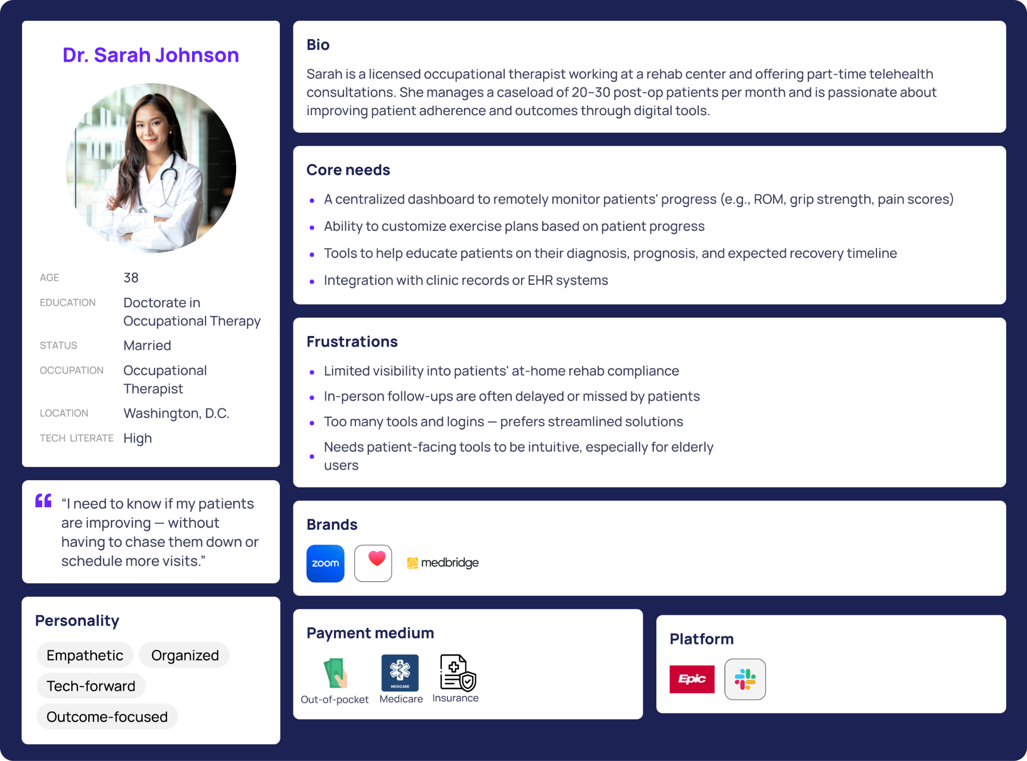

Slide 15
Features and Functions

Slide 16

Feature Overview
Patient Interface:
Provider Interface:
Complete daily pre- and post-exercise assessments (pain, grip strength, mood, sleep, fatigue)
Track progress with a visual exercise dashboard
Earn badge rewards for consistency and milestones
Access video-guided exercises assigned by therapists
Record/upload exercises for AI analysis of movement (ROM)
Play quiz games to learn about their diagnosis and recovery plan
View patient caseload list
Monitor AI-generated patient flags (e.g., pain spikes, missed sessions)
Access key rehab metrics (pain trends, grip strength, ROM progress)

Slide 17
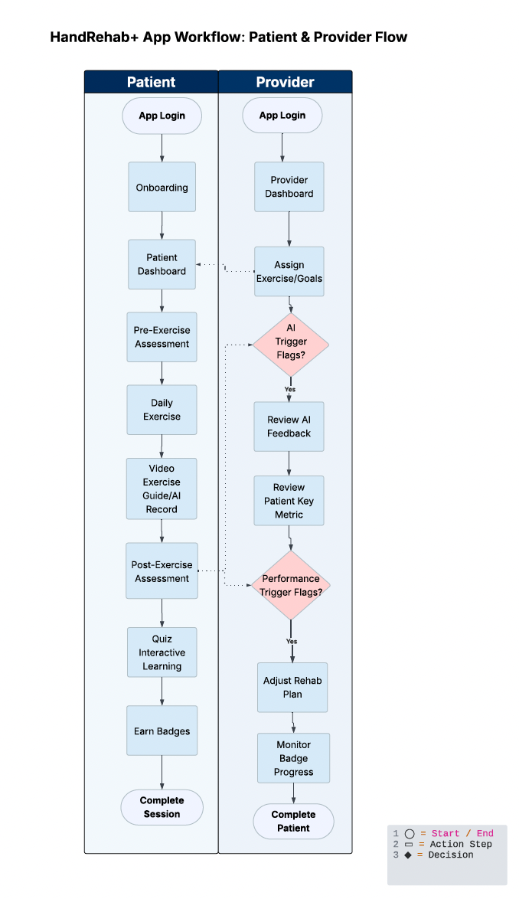
Design
Process

Slide 18


Developmental Tools and Architecture

Slide 19
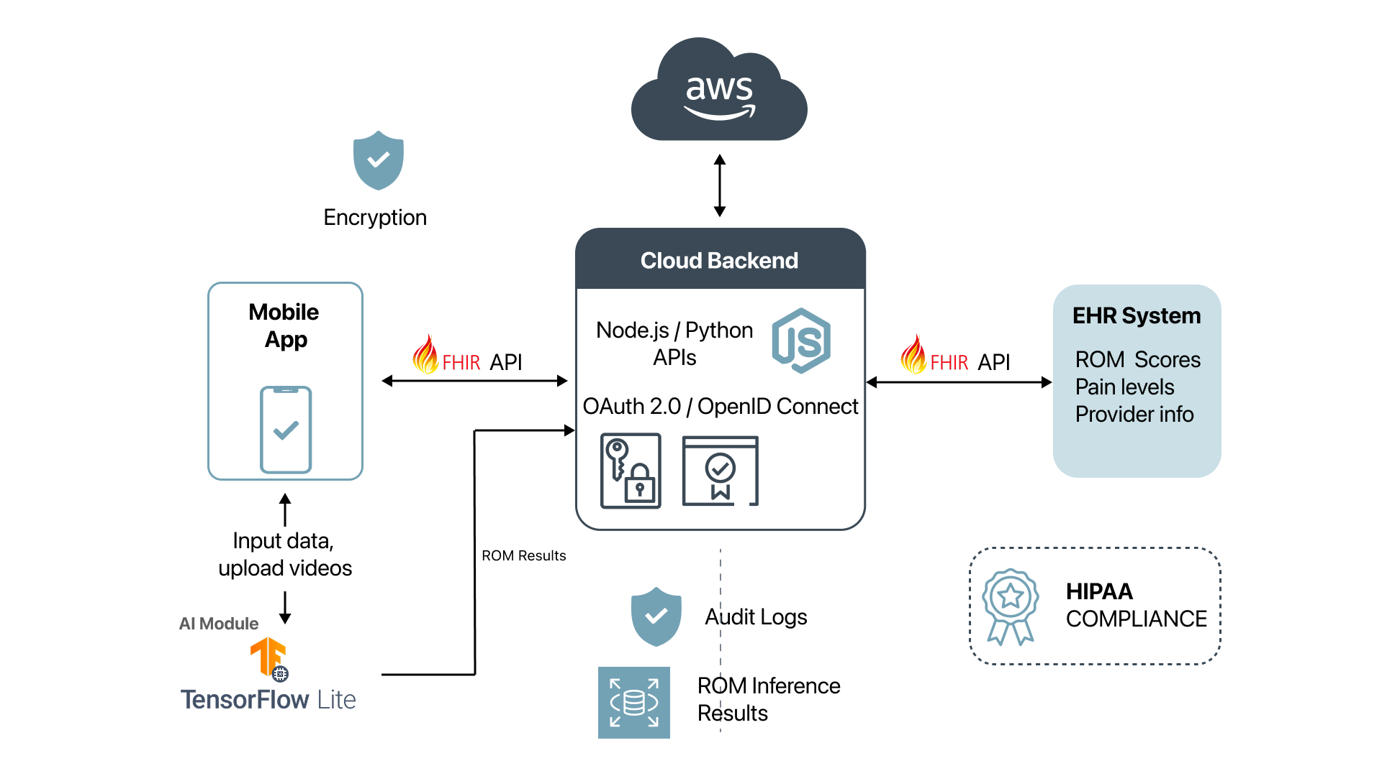

Slide 20








AFull Tech Stack
Frontend
Interface
Fast, intuitive user interface
HIPAA-compliant cloud services,
handle scalable workloads
Cloud
Backend
Real-time joint tracking & preserves privacy
AI Module

Slide 21
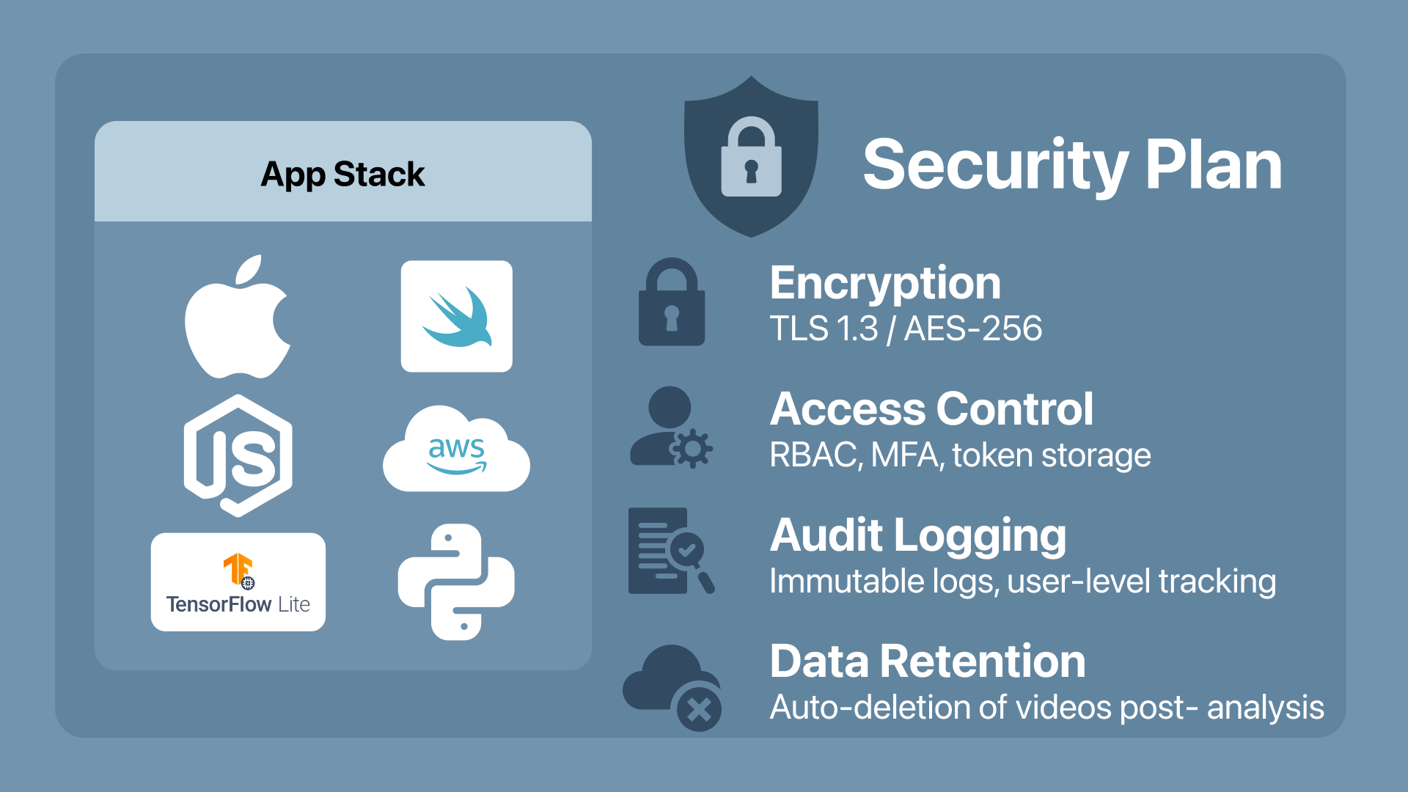

Slide 22
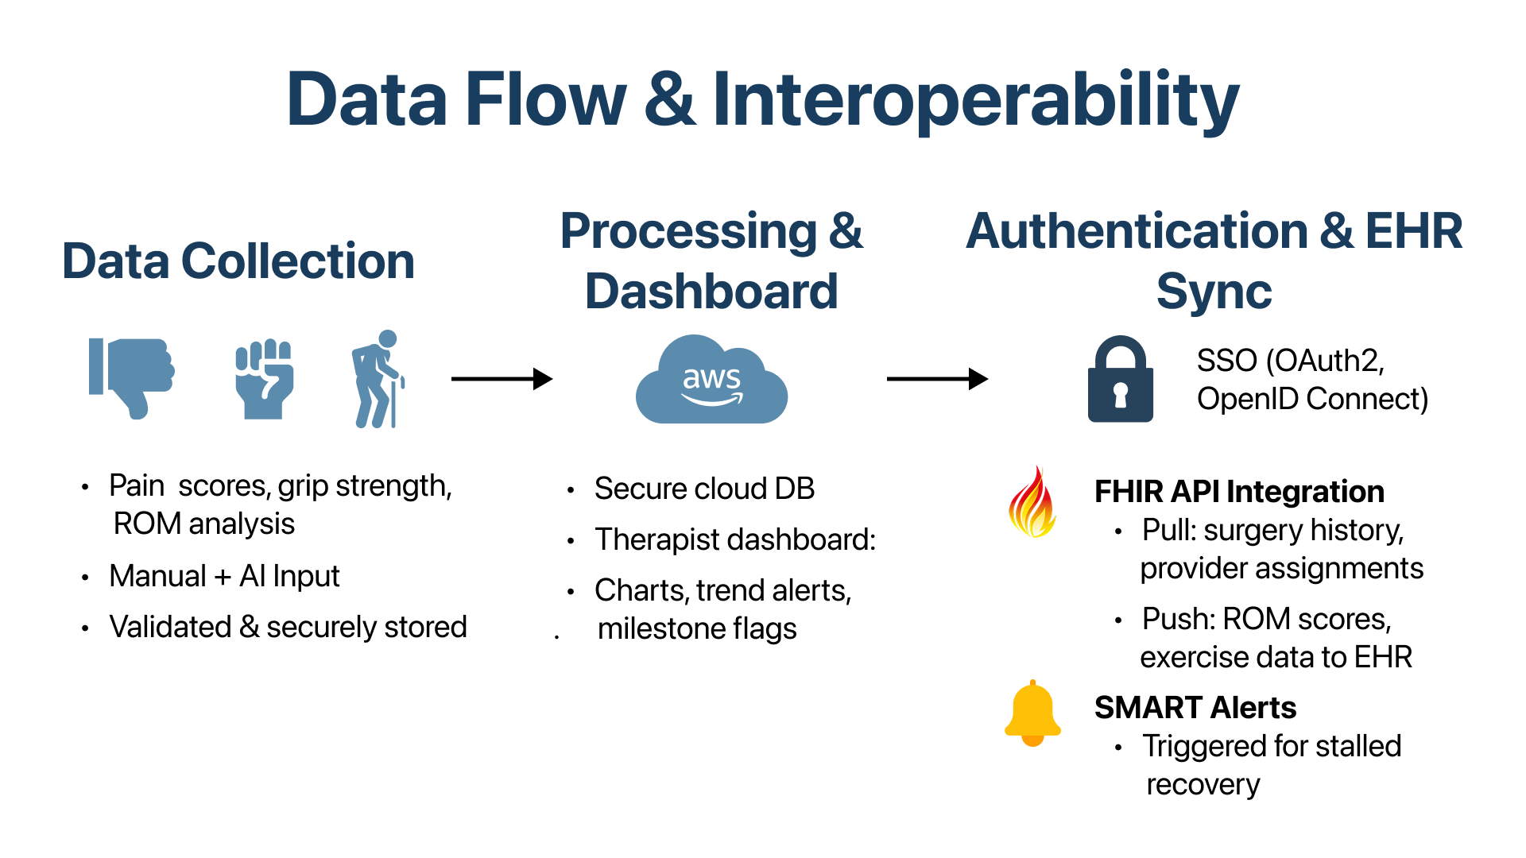

Slide 23



Usability Testing
Six participants 2 OTs, 1 PT, and 3 post-op patient
Core workflows tested
Key Feedback Themes
Pain-scale guidance. “The slider is helpful, but patient don’t always understand the numbers.” -PT
Exercise demonstration clarity. “The GIFs move to fast on my phone.” -Patient
Quiz simplicity. “Too many options it felt a bit cluttered.” - OT
Design Revisions
Login and complete pre-exercise assessment
Watch and perform recorded exercise
Fill out post quiz
complete post-exercise assessment
Pain scale tooltips. Tap icon to see guidance (e.g. “0 = No pain,” 10 = worst pain”)
Improved video playback. Replace GIFs with slow-motion MP4 video loops
Streamlined quiz. One question per screen, simplified answer choice real-time feedback

Slide 24
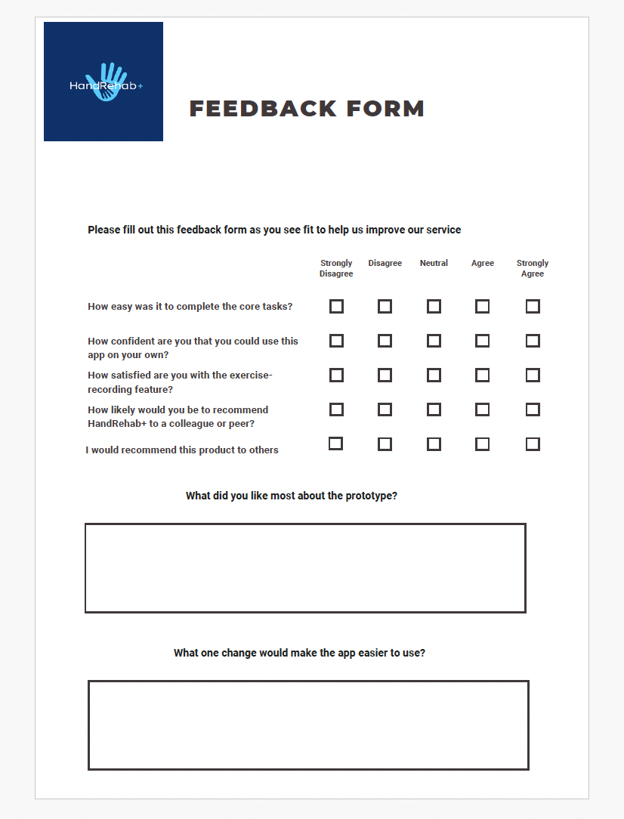

Slide 25
Implementation Plan and Future work

Slide 26













Implementation Plan
User Research
Vision Setting
Business Model
Financial Plan
Implementation
Leverage insights from provider interviews and patient surveys to validate the app’s core features: video guidance, pain logging, and therapist feedback.
Define HandRehab+ as a digital bridge between clinic and home—enhancing rehab adherence, therapist oversight, and patient motivation.
Offer HandRehab+ as a subscription-based platform for outpatient clinics, with tiered pricing by provider count and usage analytics.
Estimate pilot-phase costs for deployment, support, and training. Explore funding via NIH grants, innovation challenges, or partnerships with health systems.
Deploy to a small OT clinic (15–20 post-op patients). Train therapists, monitor engagement, gather outcomes, and refine for wider release.

Slide 27






Behavioral Insights Engine
Accessibility Expansion
Future Work
Add voice guidance, large text, and language support to improve accessibility for all users
Track in-app behavior (e.g., skipped sessions, peak activity times)
HandRehab+ will continue evolving with a focus on intelligent automation, inclusive design, and clinical impact, ensuring technology meaningfully supports recovery.
AI Form Feedback
Clinical Validation
Use computer vision to analyze hand movement and provide real-time corrections to improve form, safety, and therapy outcomes.
Run clinical pilots to measure impact on recovery.

Slide 28
DEMO
Figma + App Presentations

Slide 29

Appendices/Resources

Slide 30
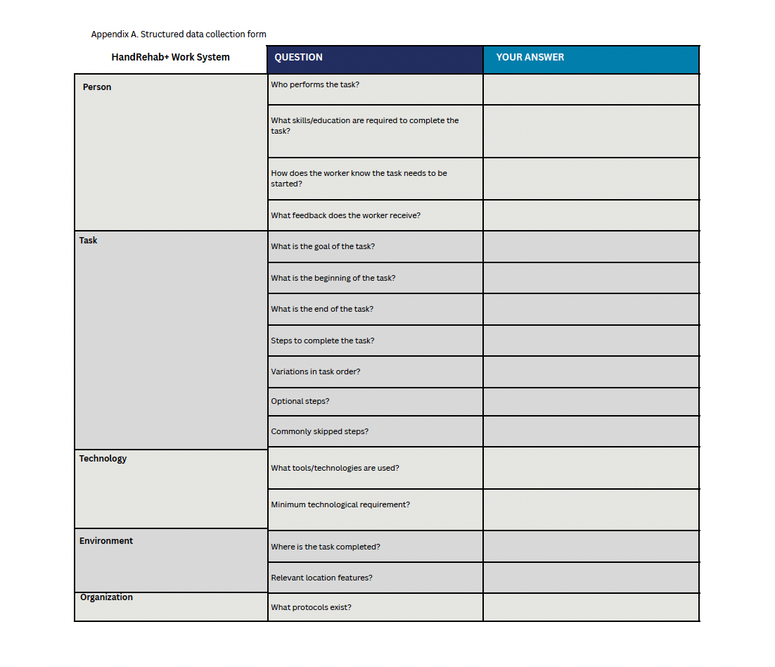

Slide 31
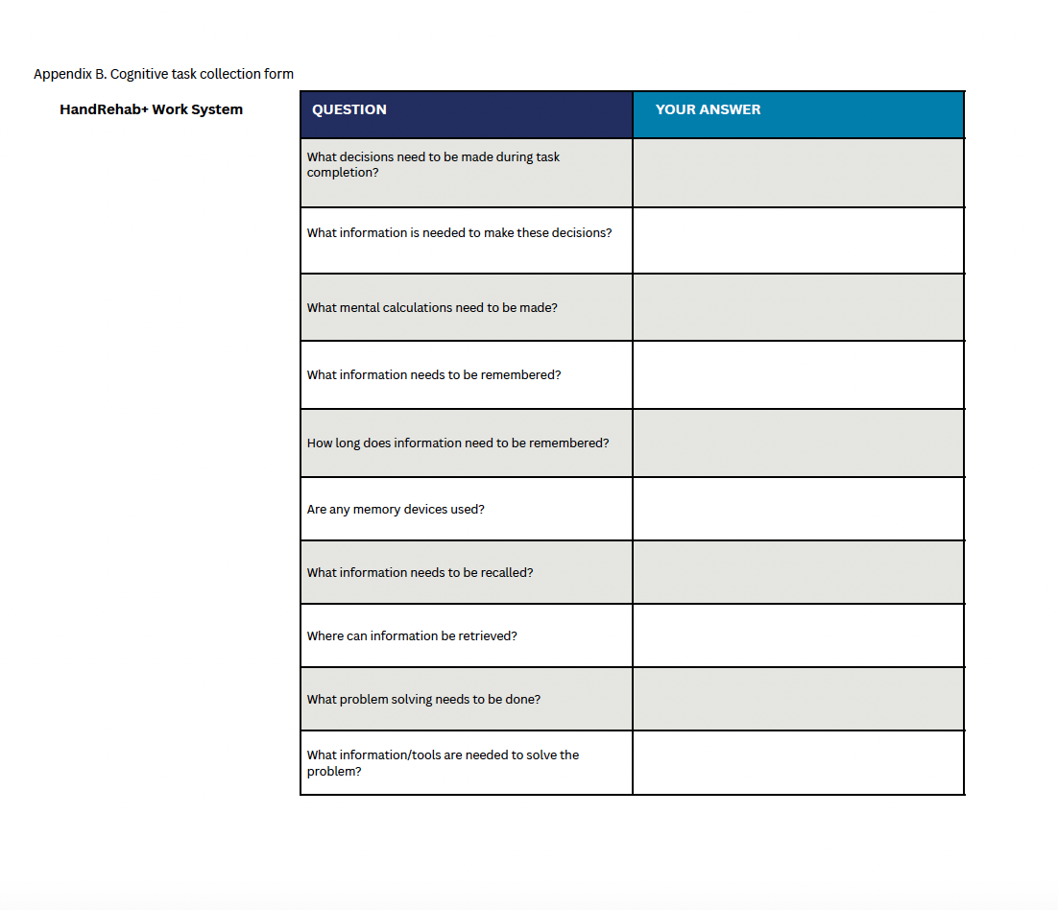

Slide 33
The Other Personas

Slide 34
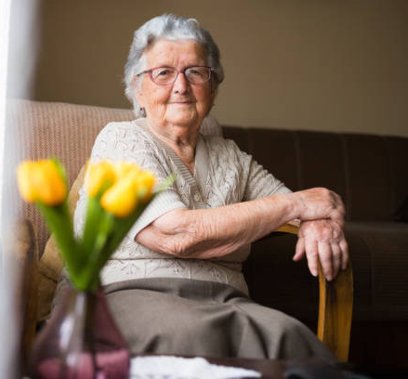
Occupation: Elder retired
Background: Lives in DC, Philadelphia native
Hobbies: Keeping her home in check
Personality: Sweet little old granny
Goal: Prepare for her grandkids visit
Condition: Recovering from partial knee replacement and hand surgery for her joints.
Needs: Simple exercise instructions, daily task assistance, balance/stability improvement.
Challenges: Limited mobility, fall concerns, managing multiple health conditions, reliance on family support.
Name: Eleanor Vance
Age: 70
Retired Grandma

Slide 35
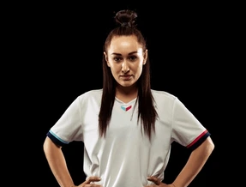
Occupation: Soccer Player
Background: Lives in DC, Brazilian native
Hobbies: Hanging out with friends
Personality: Competitive
Goal: Provide for family
Condition: Hand got broken by Soccer ball so post surgery recovery of hand.
Needs: Pain management, post-op guidance, mobility/strength recovery, joint health advice.
Challenges: Pain management, fear of re-injury, adapting to assistive devices, returning to active lifestyle (soccer).
Name: Maria Rodriguez
Age: 55
Soccer Player

Slide 36

Occupation: Certified Hand Therapist (CHT)
Background: Lives in Washington DC, Baltimore Native
Hobbies: Watching K Drama
Personality: Strict but fair
Goal: Fix broken hands to be useable again.
Needs: - Digital tool for remote patient monitoring and feedback. Challenges: - Managing multiple patients. - Ensuring adherence outside clinic visits.
Name: Dr. Emily Carter
Age: 32
Single

Slide 37

Occupation: Orthopedic Surgeon (Sports Injuries Specialist)
Background: Lives in Washinginton DC, Arlington Native
Hobbies:
Personality: Friendly and Shy
Goal: Provide best service of medical help to those in need
Needs: - High-resolution imaging access for pre-surgery planning. - Streamlined system to track patient recovery milestones. - Patient education tools for injury prevention and rehabilitation.
Name: Dr. Marcus Hayes
Age: 52
Father of One Child

Slide 38

Program Language + The Prototype

Slide 39

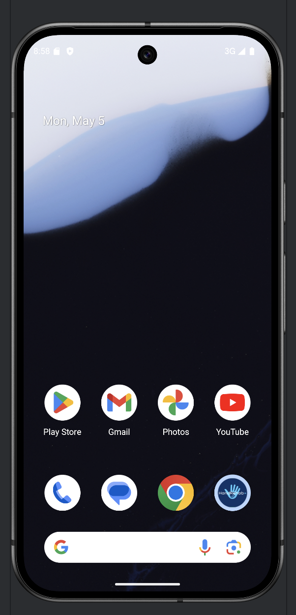
The Language Model
Prototype name: Taco Tuesday
The Language: Kotlin
System/Frontend: Android
Version: API Baklava
Phone Model: Pixel 9
Manufacturer: Google
Editor: Android Studio
Emulator: Pixel 9 API Baklava
Project Name: “HandshakePlus”
Difference from wire to prototype does show.
Sign-up has “password” and “email” to save into the app.

Slide 40



The Next Model
The Next model should also work with Apple Iphones & Linux products.
Next model should also support SQL Databases to hold patient data.
If patient data gets too big AWS or Google Cloud should be considered.
Should Support Older systems of IOS and Android.
Surveys should be able to send notifications to provider along with Email.

Slide 41
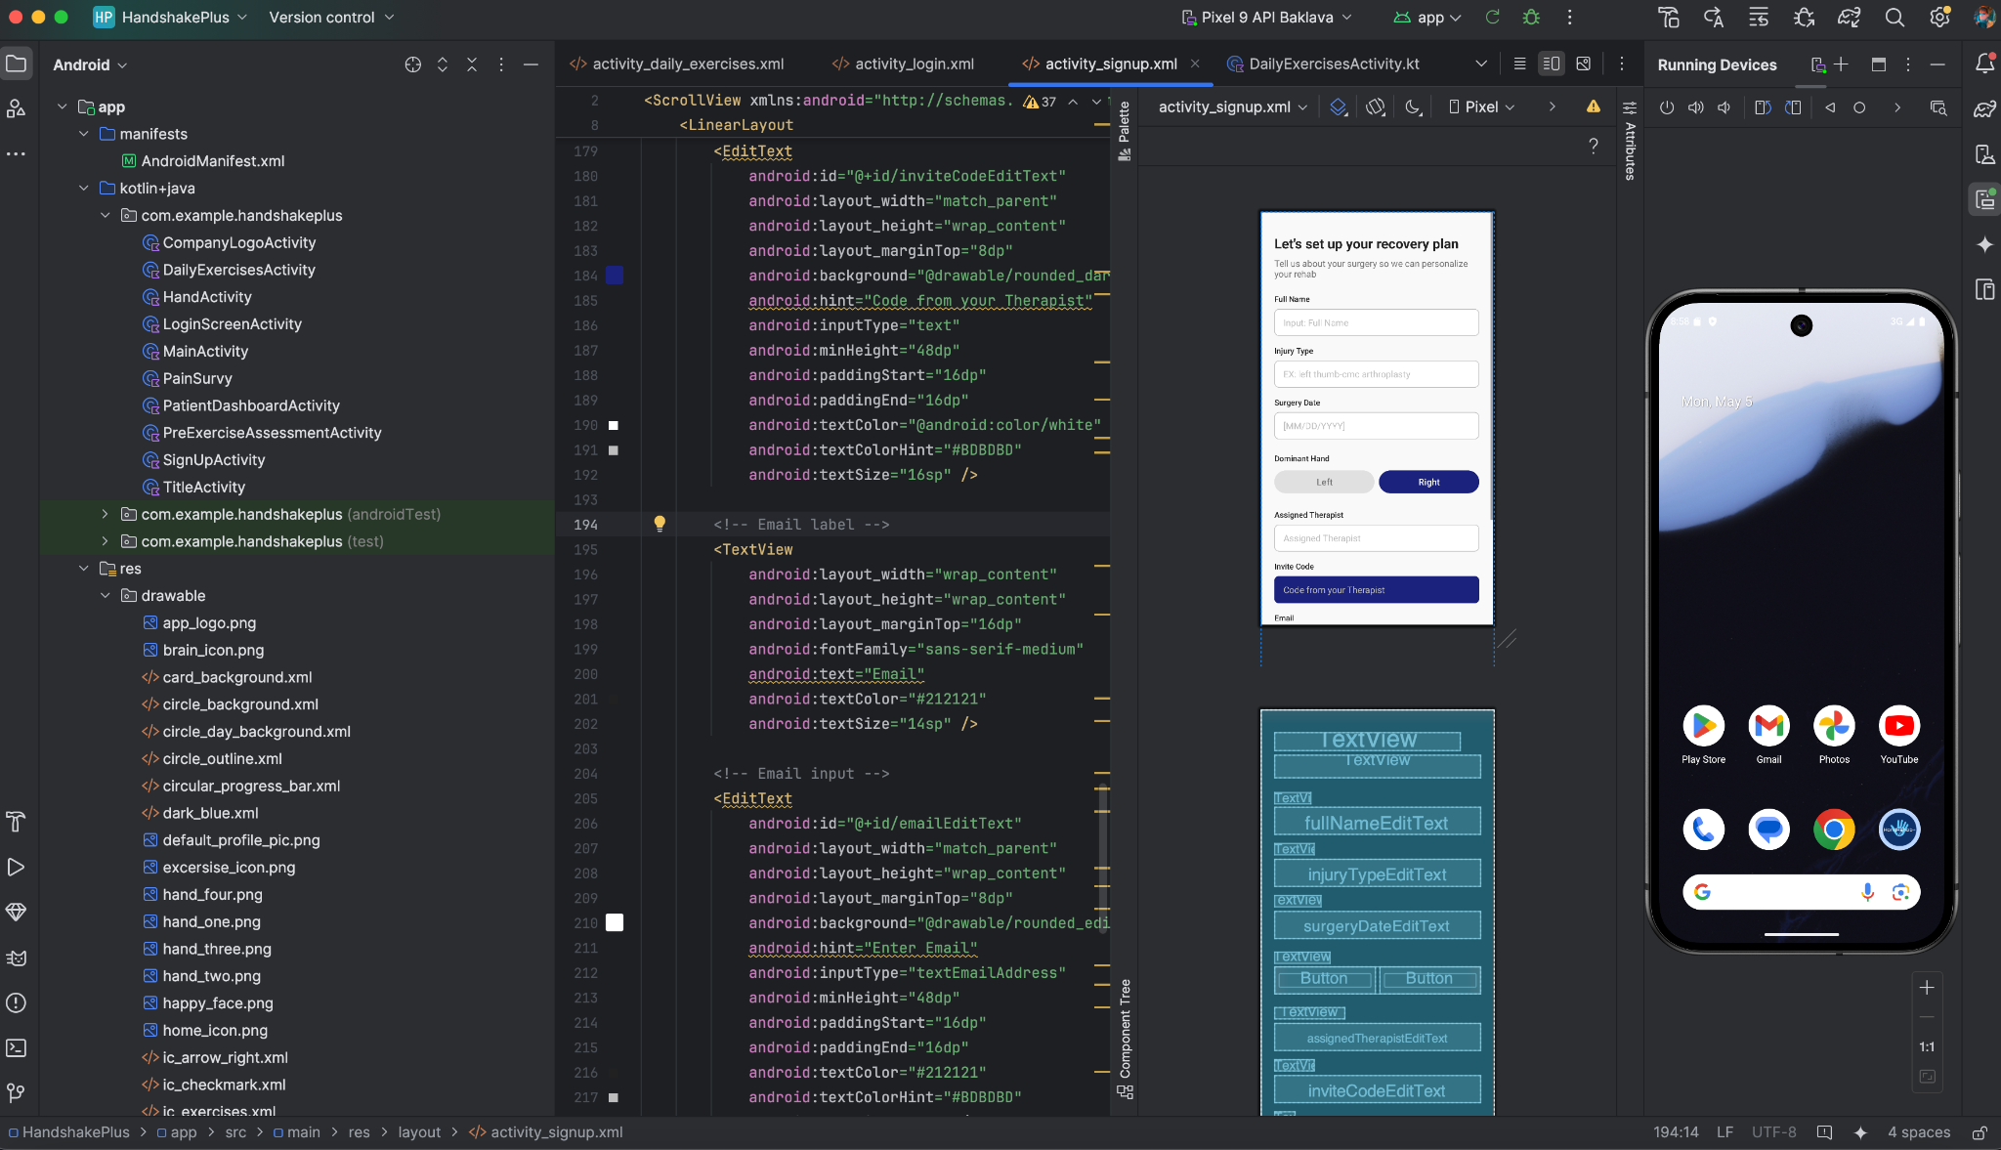

Slide 42
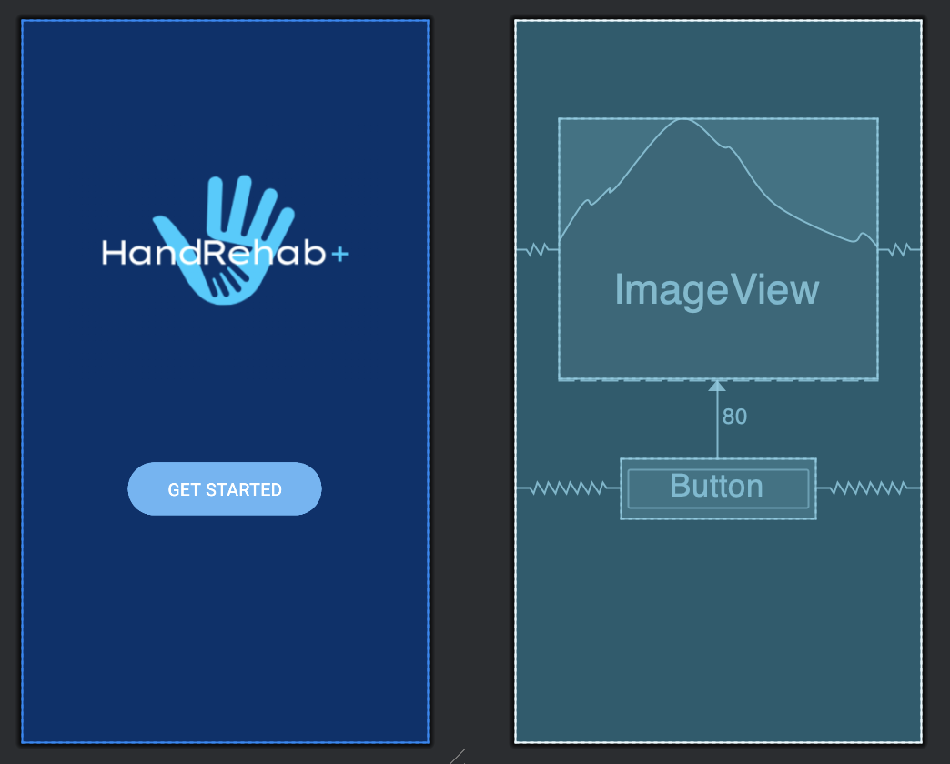
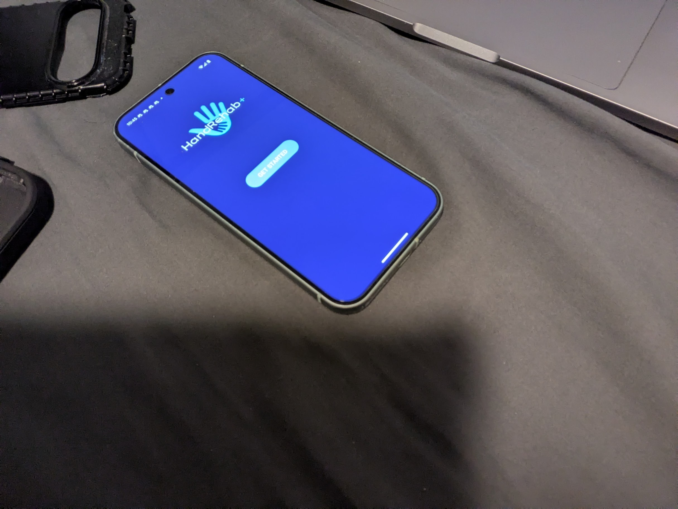
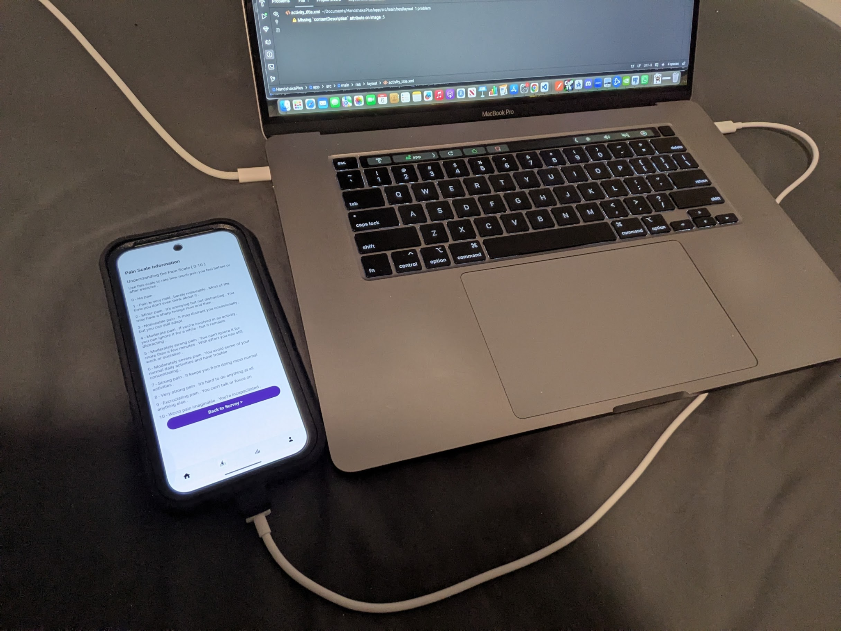
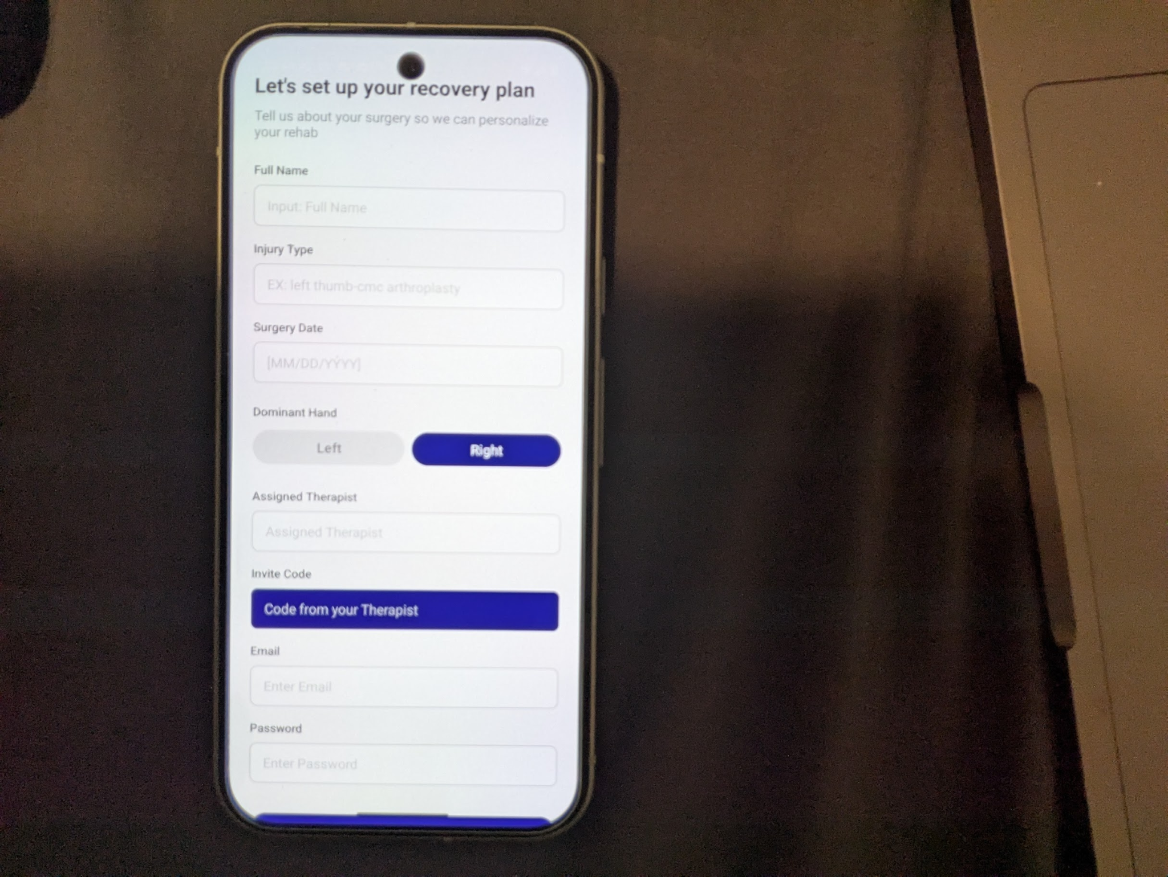
Photos of App (Prototype)

